Slide 1
Breakout activity –2021
In your groups –
https://www.kaggle.com/alexisbcook/manipulating-geospatial-data
See this Video
Install Folium
Pick a latitude and Long to display map
Home work -Use Chloropeth to integrate Data

Slide 2
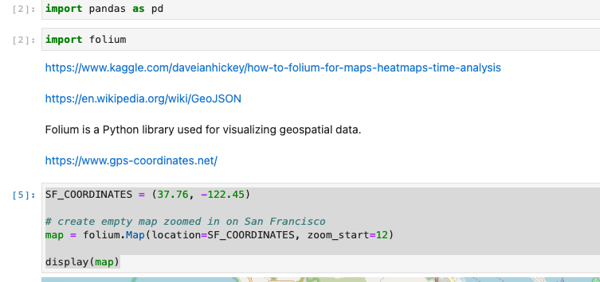
Code snippet

Slide 3
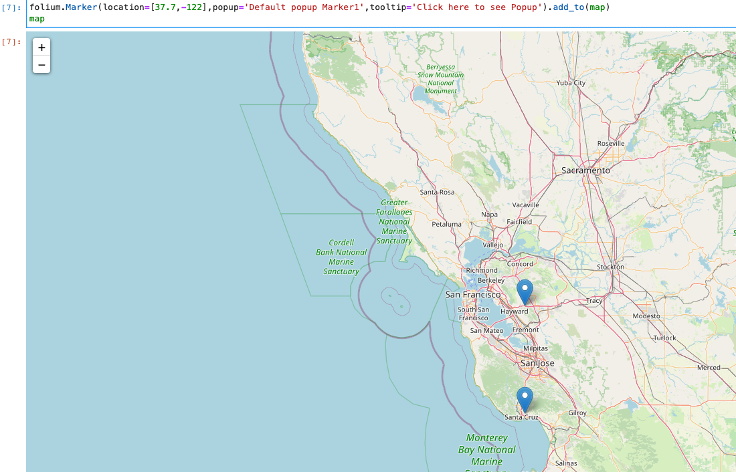
Insert a folium Marker

Slide 4
Code sample with data merged
Import Libraries.
import pandas as pd import folium
#Gather Data.
covid_data = pd.read_csv("https://api.covid19india.org/csv/latest/state_wise.csv") states_data = pd.read_excel('https://github.com/hrshah211/Corona-Map/raw/main/States.xlsx’)
#Organize Data.
covid_trunc = covid_data.iloc[1:] states_data.columns = ['State','Latitude','Longitude’]
#Merge Data Frames. merged_data = pd.merge(covid_trunc.sort_values(['State']),states_data.sort_values(['State'])) #Setup the Map - pointing to Nagpur(Center of India) so that the map is focused on India equally. map = folium.Map(location = (21.146039, 79.085036), zoom_start = 5)
#Add markers to the values on the data frame.
for i in range(len(merged_data)): color_set = 'red' if merged_data.loc[i,'Active'] > 0 and merged_data.loc[i,'Active'] < 2500: color_set = 'green' if merged_data.loc[i,'Active'] > 2500 and merged_data.loc[i,'Active'] < 5000: color_set = 'beige' if merged_data.loc[i,'Active'] > 5000 and merged_data.loc[i,'Active'] < 7500: color_set = 'orange' folium.Marker([merged_data.loc[i,'Latitude'], merged_data.loc[i,'Longitude']], popup="<b>" + merged_data.loc[i,'State'] + " </br> <label style="'color:blue;'">Total : " + str(merged_data.loc[i,'Confirmed']) + "</label>" + " </br> <label style="'color:green;'">Recovered : " + str(merged_data.loc[i,'Recovered']) + "</label>" + " </br> <label style="'color:red;'">Active : " + str(merged_data.loc[i,'Active']) + "</label>" + "</b>", tooltip=merged_data.loc[i,'State'], icon=folium.Icon(color=color_set)).add_to(map)
map

